Slide 1
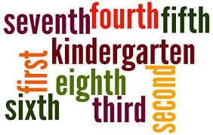
Welcome! Please sit with your grade level/subject

Slide 2
Introductions
Erika Karam (ekaram@dallasisd.org)
Julisa Martinez (julmartinez@dallasisd.org)
Lesya Yakovuk (lyakovuk@dallasisd.org)
Notes:
Todas

Slide 3
Class Norms
Listen fully and reflectively
Participate
Support one another in learning
Take care of yourself
Monitor all personal technology
Your best resources are the people around you!
Take time to meet each other during breaks and exchange contact info.
Notes:
Lesya

Slide 5
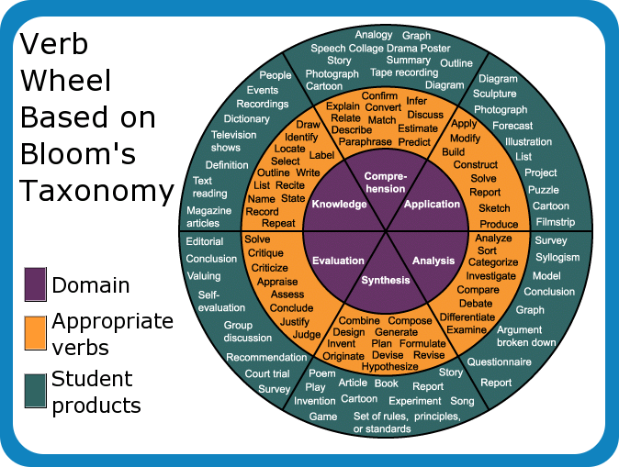
LO: I will analyze major learning theories and learning styles.
DOL: Using my knowledge of learning theories and learning styles, I will generate a relevant activity to use in my classroom.
Notes:
Lesya

Slide 6
Why Study Learning Theories?
Theories present a systematic way of understanding events, behaviors and/or situations.
In other words, this session is designed to give you a broad picture of different learning theories and how it affects student learning in your classroom.
Notes:
Lesya

Slide 7
Learning Theories
What is learning?
Learning is the acquisition of knowledge or skills through experience, study, or by being taught.
What is the purpose of learning?
The purpose of learning is so that a student will apply deductive reasoning to life situations. Previous learning will be applied to new situations to solve problems.
Notes:
Lesya

Slide 8
Learning Theories
Learning is passive and/or active
Passive: Where the learner receives no feedback from the instructor on his or her efforts. Learners receive information and (are supposed to) internalize it.
Active: Process where learners engage in activities, such as reading, writing, discussion, or problem solving that promote analysis, synthesis, and evaluation of class content.
Notes:
Julisa y Erika

Slide 9
Learning Theories
Passive versus Active Learning
The passive learning environment employs a teacher who lectures or dictates information and answers. The teacher pours facts into student minds and as a result students are measured by a multiple-choice or true-false questions.
The active learning environment employs a teacher who stimulates students to learn for themselves by asking questions, posing problems, and allows the learners to search for the answers and then discuss the answers. Students become involved.
Notes:
Julisa y Erika

Slide 10
Questions:
Which type of learning (active or passive) would most likely require students to use high order thinking skills? Explain your answer
Which type of learning(active or passive) would foster students to become life long learners? Explain your answer
Which type of learning (active or passive) will you use the most in your classroom. Why would you use this type of learning? Explain
Notes:
2 min discuss in your table, share with the class – Lesya

Slide 11
The Cone of Learning
Study the following slide entitled The Cone of Learning.
Questions
Look at the percentages and determine where long term memory takes place.
How should you structure your lesson plans to ensure the learning is being transferred to your students in their long term memory-not just for the test, but for life?
Notes:
Lesya

Slide 12
Notes:
Lesya

Slide 13
Learning Theories
Barriers to learning in the classroom
Socio Economic Barriers –Effective learning is influenced by availability of
educational resources to meet student needs.
Social and Cultural Barriers – A child’s ability to interact socially with their peers
has a significant impact on how they progress in the classroom
Emotional Factors – A student’s emotional wellbeing impacts their ability to
do well in school.
Personal issues – Difficulties like autism, Asperger’s syndrome or other learning difficulties impact student learning.
The number 1 barrier to learning is on the next slide!
Notes:
Julisa

Slide 14
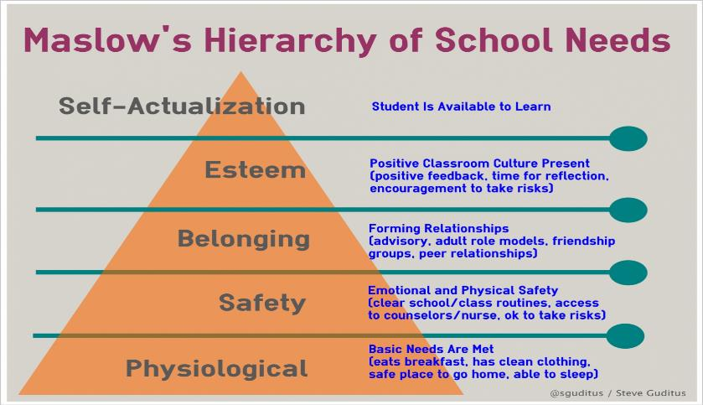
Learning Theories
Notes:
Erika

Slide 15
Learning Theories
You can’t get to Bloom’s until you get through Maslow.
Is this statement true or false? explain your answer
Notes:
Everyone – discuss and give ideas

Slide 16
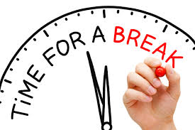

Slide 17
Learning Theories
Cognitive, emotional, and environmental influences, as well as prior experience, all play a part in how students learn and understand.
A students view of the world is acquired or modified based on how the student obtains and retains knowledge.
Notes:
Julisa

Slide 18
Learning Theories
Learning Theories are conceptual frameworks that describe how information is absorbed, processed, and retained during learning.
A conceptual framework is used in research to outline possible courses of action or to present a preferred approach to an idea or thought.
A learning theory gives a teacher different ways to create a lesson based on their learner’s development.
We will look at three learning theories.
Notes:
Julisa

Slide 19
Types of Learning Theories
Behaviorist Learning Theory
Cognitive Learning Theory
Constructivist Learning Theory
Notes:
Julisa

Slide 20
Teaching Johnny
Notes:
Questions: What is the best why to teach Johnny how to spell? Which learning theory will be the most effective? Why

Slide 21
Behaviorist Theory
Key Idea
The theory assumes all behaviors are reflexes or consequences to a stimulus.
1. Students are passive learners
2. Learning through observation
3. Student behavior is a blank slate

Slide 22
Behaviorist Theory
The theory that human behavior can be explained in terms of conditioning without regard to thoughts or feelings. Behaviorism assumes that all behaviors are reflexes produced by stimuli or consequences like reinforcement. Stimulus/Response

Slide 23
Behaviorist Theory
Behaviorism believes people learn through association and there are two types of associative learning:
Classical
Operant

Slide 24
Behaviorist Theory
Classical Conditioning – Learning occurs through the associations between events.
Operant Conditioning – Learning occurs from consequences. All behavior caused by external stimuli without consideration of internal mental status.

Slide 25
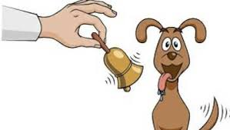
Classical Theorists
1. Pavlov: Pavlov won the Nobel Prize for his experiments on dogs.
Pavlov’s dogs were classically conditioned to the stimulus (a bell) to salivate even when there was no food visible.
Pavlov therefore demonstrated how stimulus-response bonds are formed.
Many scientists consider this to be the basic building blocks of learning.
What does this Nobel Prize Winning experiment have to do with your students?
Notes:
How will you use reinforcers in your classroom to help leaners?

Slide 26
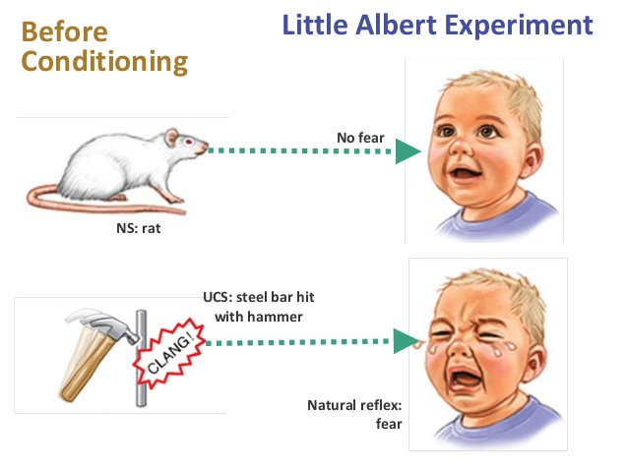
Classical Theorist
John Watson- Further extended Pavlov’s work by applying it to humans.
He taught an 11 month old to fear rats by associating a white rat with a loud noise. (Imagine this type of experiment occurring today)
This type of classical conditioning suggested that behavior could be changed by using different types of stimuli.

Slide 27
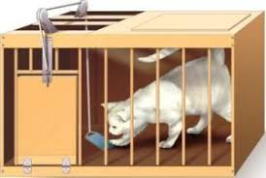
Operant Theorist
Thorndike studied the behavior of cats in a maze.
His work led to the Law of Effect which stated that any behavior that is followed by a pleasant consequence is likely to be repeated.
Any behavior that is followed by unpleasant consequences is likely to be stopped.

Slide 28
Operant Theorist
B.F. Skinner - Continued the work of Thorndike. Events that follow a response (pleasant or unpleasant) will increase or decrease the likelihood that the response will be repeated.
B. F. Skinner was one of the most influential of American psychologists. A behaviorist, he developed the theory of operant conditioning -- the idea that behavior is determined by its consequences, be reinforcements or punishments, which make it more or less likely that the behavior will occur again.

Slide 29
* Check for understanding
1. Name two types of behaviorism
______________
______________
2. Pavlov won the Nobel Prize for his experiments working with dogs.
True or False
3. Behaviorism states that learning is:
a. Active c. Voluntary
b. Passive

Slide 30
Cognitive Theory
Key Idea
The theory explains mental processes as they are influenced by factors, which eventually bring about learning in an individual.
Students are active learners.
Thinking and remembering are internal events.
The organism as an active processor of information.

Slide 31
Cognitive Theory
Wilhelm Wundt
“…intervening variables are appropriate and necessary components for understanding the processes of learning.”

Slide 32
Cognitive Theory
Intervening variables are the other behaviors that become part of the process of learning.
… the organism as an active processor of information that modifies new experiences, relates them to past experiences, and organizes this information for storage and retrieval.
Cognitive psychologists also recognize that learning can take place in the absence of overt behavior.

Slide 33
Cognitive Theory
The students in this case are active learners, building new schemas, adding new and old experiences, saving information as memories which can be retrieved at any time.
You don’t have to see learning taking place for it to happen.
Notes:
A schema is a general idea about something. Its plural form is schemata. Schemata can help students learn. In order to use schemata in education, teachers should activate prior knowledge, link new information to old information and link different schemata to each other.
schema, relevant background knowledge, prior knowledge, or just plain experience, when students make connections to the text they are reading, their comprehension increases. Good readers constantly try to make sense out of what they read by seeing how it fits with what they already know.

Slide 34
Cognitive Theory
Concerned with the influence of thinking about and remembering experiences or behavior
Distinction between performance and learning
Performance doesn’t always reflect what was learned

Slide 35
Cognitive Theory
Transfer of information and skills between school and home:
delivery of Information is designed to produce transfer and use thinking skills
Viewing of materials over time
Variety of examples
Practice retrieval with feedback

Slide 36
Cognitive Theory
Thinking and remembering are internal events
they cannot be measured.
This theory assumes that while all creatures can learn, some types of learning are unique to humans (language).

Slide 37
Major Assumptions
Major Assumptions: behaviorist and cognitive theories
Behavior is influenced by experience
Learning is adaptive for the individual
Learning is a process governed by natural laws that can be tested and studied

Slide 38
Major Assumptions
Young children do not have the experiences we have as adults, we have lived longer and gone through many events in life.
Those events fashioned behaviors that we exhibit beyond the time of the event. We adapt, change, as a result of the experiences we live: in our lives with family, in your profession, in our learning, in interaction with others.

Slide 39
Checking for Understanding
True or False:
You have to see learning taking place for it to happen.
2. Name two major assumptions of behaviorist and cognitive theories and explain their implications in the teaching and learning process.
Notes:
1

Slide 40
Constructivist Theory
Key Idea
The theory explains the nature of knowledge. Views are more focused on human development and the context of the social world
Students are interactive learners.
2. Focus is on how we make meaning in interaction between experience and ideas.
3. Genetic make up defines how you develop intellectually.

Slide 41
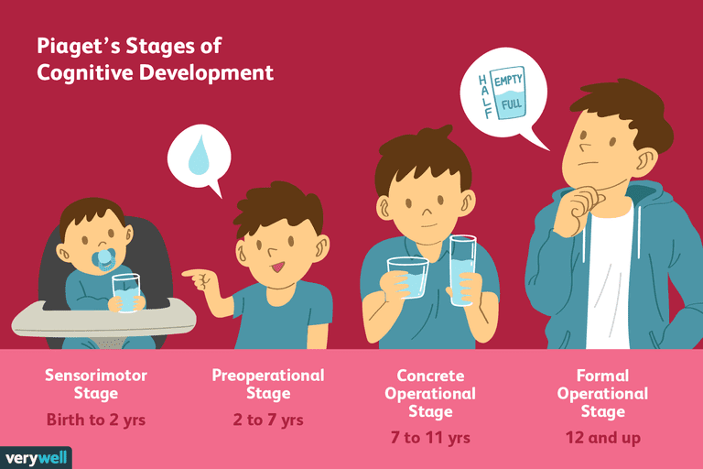
Constructivist Theorist
Piaget
Intellectual development determined by genetics.
Propose 4 stages of human development
Sensory motor – the execution of voluntary movements
Preoperational – symbols of language and manipulation of objects
Concrete operations – Children begin thinking logically about concrete concepts
Formal operations - Develop the ability to think about abstract concepts

Slide 42
Constructivist Theorist
Vygotsky
His relevance to constructivism derives from his theories about language, thought, and their relationships by society
Learning environments should involve guided interactions that permit children to reflect on inconsistency and to change their conceptions through communication
Artifacts play a central role in learning

Slide 43
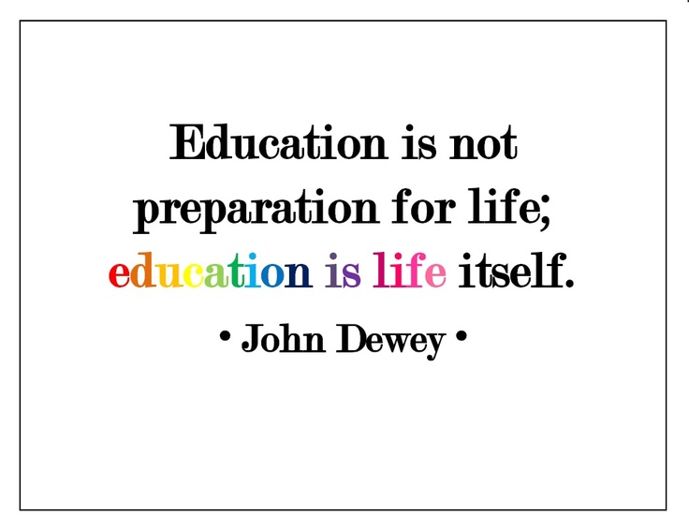
Constructivist Theorist
Dewey
Education depends on action
Knowledge and ideas emerge only from a situation in which learners have to draw out experiences that have meaning and importance to them
Problem solving experiences occur in a social context

Slide 44
Constructivist Theorist
Piaget
Transformation in learning and development
Vygotsky
Learning and development are tied to communicative interactions with others
Dewey
Schools have to bring real world problems into the curriculum

Slide 45
Constructivist Theory Involves
Constructivism
Prior Knowledge
Real & Authentic Problems
Cognitive conflict & Social context
Assessment
Technology
Teacher’s Role

Slide 47
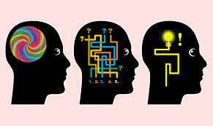
Learning Styles Test
Notes:
Lesya

Slide 48
Learning Styles Test
A Learning style is a group of characteristics, attitudes, and behaviors that define our way of learning.
A learning style is a particular way in which the mind receives and processes information.
Notes:
Lesya

Slide 49
Learning Styles
Notes:
Lesya

Slide 50
Checking for Understanding
List 3 types of learning styles:
____________
____________
____________
According to Constructivism, students are _________ learners
A: Passive
B: Active
C. Interactive
Notes:
Everyone

Slide 51
Applying Learning Theories in the classroom

Slide 52
Activity Planning using Learning Theories and Styles
In your group brainstorm activities you can use next week that will appeal to different learning styles and apply relevant learning theory information you learned. (30 min)

Slide 53
Activity Planning using Learning Theories and Styles
Ideas:
Bell ringer
Learning center
DOL
Debate
Games
Skits
Presentations
Research project
Choice boards

Slide 55
Learning Theories Presentation
Activity (modified 4 corners):
Each table send a representative to share your activity with the other groups

Slide 56
Q & A

Slide 57
Helpful Resources
Lead4ward
Teachers Pay Teachers
TEA STAAR Released tests
Pinterest
TEA school report card
Facebook – join a group
msyakovuk.weebly.com
teachingteacher.weebly.com
Mysterydoug
Brainpop and Brainpop Jr. – ask your librarian
iStation
Education galaxy
Achieve 3000
TMSCA and UIL
Pre-K TLCs
Khan Academy

