Slide 1
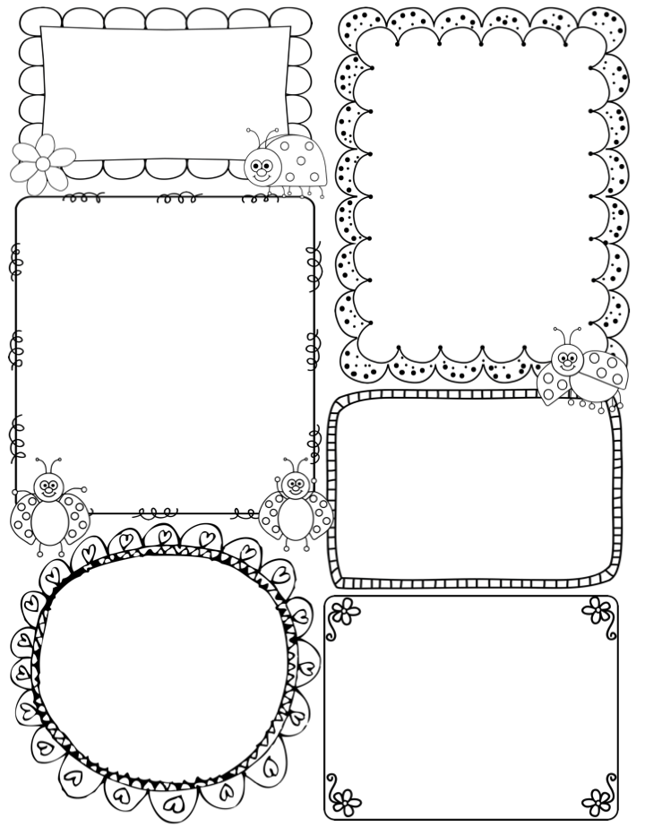
The News
Ms. Yakovuk
3/3/2015
In Need of Supplies
.
Math Objectives:
.
Important Dates:
.
STAAR DATES:
.
Contact Information
.

