Slide 1
Classroom Management
Lesya Yakovuk
Erika Karam
Julisa Martinez

Slide 2
Introductions:
Erika Karam – ekaram@dallasisd.org
Julisa Martinez – julmartinez@dallaisd.org
Lesya Yakovuk – lyakovuk@dallasisd.org

Slide 3
What is Classroom Management?
Classroom management creates a set of expectations used in an organized classroom environment. It includes routines, rules and consequences. Effective classroom management paves the way for the teacher to engage the students in learning.
All of the things a teacher does to organize students, space, time, and materials so student learning can take place.

Slide 4
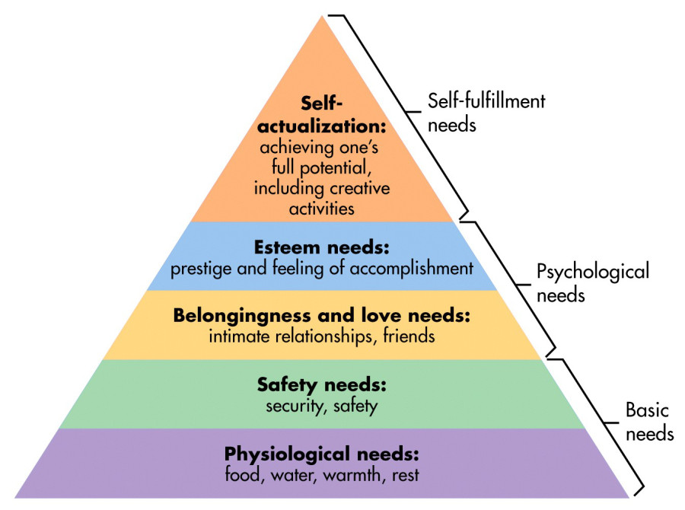
Students Cannot Learn Until …

Slide 5
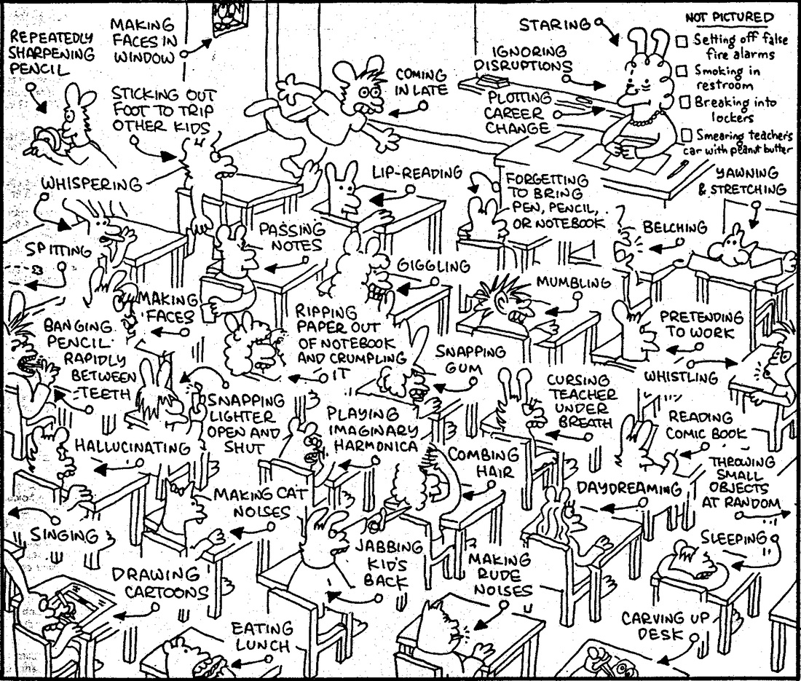

Slide 6
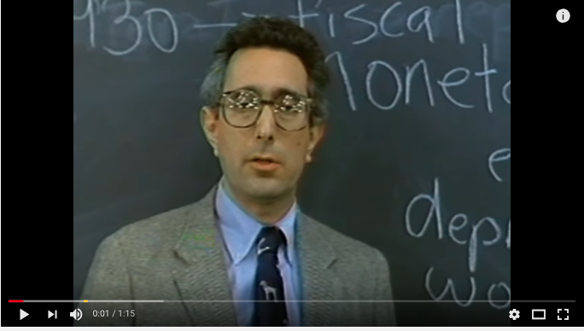
Boring Teacher: https://www.youtube.com/watch?v=uhiCFdWeQfA

Slide 7
Classroom Management Styles
1. Love and Logic
2. Capturing Kids' Hearts
3. Whole Brain Teaching
4. Positive Discipline
5. Discipline with Dignity
6. Assertive Discipline

Slide 8
BREAK!

Slide 9
Establish Routines
A disorganized classroom without routines and expectations makes it difficult for the teacher to do her job.
Classroom management strategies help create an organized classroom environment that's conducive to teaching. Kids know the expectations in different types of learning situations.
Taking time before school starts to create routines and procedures saves you time in the long run. When the children know what to do, it becomes a natural part of the routine.

Slide 10
Consistency
Set clear expectations
Align your management strategies with the schoolwide standards
Students need to know what to expect everyday when it comes to routines

Slide 11
Effective classroom management gives the students little time to misbehave. Because the expectations are clearly explained, the students know what they need to do.

Slide 12
Classroom Culture and Climate
Establish a POSITIVE classroom culture
Greet your students every morning
Morning Message and closing circle
Make sure students feel that they are valued and appreciated
Say 3 positives for each negative
Call and Response signals

Slide 13
Tips for Greeting Students
https://youtu.be/8XzIszEQbjg

Slide 14
Establishing Rules
Let students take part in the creation of classroom rules or norms
Value their opinion
Keep rules to a maximum of 5
Word the rules POSITIVELY
Instead of: DO NOT BE DISRUPTIVE
Try: STAY ON TASK

Slide 15
Classroom Rules Activity
Write/Share 5 classroom rules, rewards, and consequences
Be ready to share!

Slide 17
It’s all about the SYSTEMS

Slide 18
Hand Signals

Slide 19
Use Timers

Slide 20
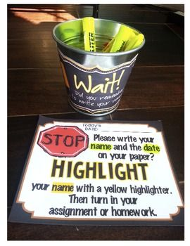
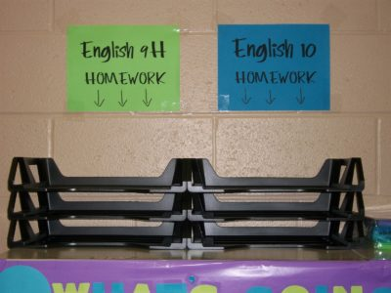
Turn in Work

Slide 21
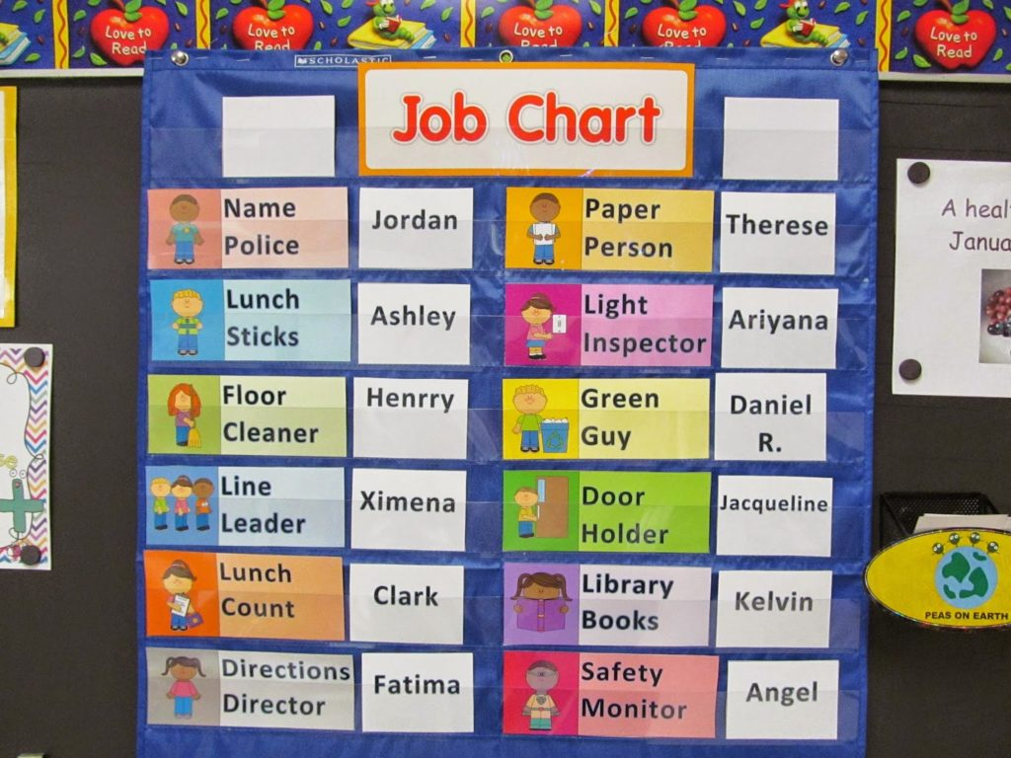
Give them Jobs

Slide 22
BREAK!

Slide 23
Activity: Student Surveys
Look at the survey the students will take at the end of the year.
What should you focus on?

Slide 24
Mistakes new Teachers make
Have not figured out what exactly they want and don't want - a root cause of much of what follows.
Overpraise students for doing what is expected.
Fail to do effective long-range and daily planning.
Spend too much time with one student or one group and not monitoring the entire class.
Begin a new activity before gaining the students' attention.
Talk too fast, and are sometimes shrill.
Stand too long in one place (the feet of clay syndrome).
Sit too long while teaching (the posterior of clay syndrome).

Slide 25
Mistakes new Teachers make
Overemphasize the negative.
Do not require students to raise hands and be acknowledged before responding.
Are way too serious and not much fun.
Are way too much fun and not serious.
Fall into a rut by using the same teaching strategy or combination of strategies day after day.
Tend to talk to and interact with only half the class (usually their favorites, and usually on the right).
Interrupt students while they are on task.
Use "SHHHH" as a means of quieting students (one of the most annoying and ineffective behaviors).

Slide 26
Mistakes new Teachers make
Overuse verbal efforts to stop inappropriate student behavior - talk alone accomplishes little.
Settle for less rather than demand more.
Use threats to control the class (short term, produces results; long term, backfires).
Verbally reprimand students across the classroom (get close and personal if possible).
Do not intervene quickly enough during inappropriate student behavior.
Do not learn and use student names in an effective way (kids pick up quickly on this and respond in kind).
Read student papers only for correct answers and not for process and student thinking.
Ask global questions that nobody likely will answer.
Fail to do appropriate comprehension checks to see if students understand the content as it is taught.

Slide 27
Mistakes new Teachers make
Use poorly worded, ambiguous questions.
Try to talk over student noise (never, ever, do this, because when you do, you lose and they win).
Are consistently inconsistent.
Will do anything to be liked by students.
Permit students to be inattentive to an educationally useful media presentation (this happens a lot).
Introduce too many topics simultaneously (usually the result of poor planning).
Take too much time to give verbal directions for an activity (an inability to focus and explain effectively).
Take too much time for an activity (usually the result of poor planning).
Overuse punishment for classroom misbehavior - going to an extreme when other consequences work better.

Slide 28
Good Ideas
* Be proactive. Call parents early with a positive praise for every student. That way you will establish positive rapport. Especially for those kids who you know will be trouble
* Learn about your students as much as possible. Talk to the last year’s teachers if possible, check MyData Portal for scores
*Establish your classroom rules and expectations and STICK to them. Be consistent. Watch what the kids are doing (they WILL test the limits
*Don’t be afraid to be strict and firm at first. You can let things slide later. Show them who the boss is and that the classroom is not a democracy. (Use appropriately based on grade level)
* Have students working at all times, have extra things to do. Less free time, less trouble

Slide 29
Good Ideas
* Do not worry about the cutsie activities. Teach what matters, teach the basics if students lack them. Get down to their level and build them up. That is what really matters. If you work to bring up the low learners, you will not have time to waste on the cute stuff. (Based on the grade level! Use common sense!)
* If you have students way below level, do a group lesson on what the TEK requires using the materials on level and then pull students into the small group and use the materials on their level. It is possible to work on summary or main idea using picture books (if that is what the student can read). After a few weeks you will begin moving these students up.
* Small groups are done, so you can meet individual needs of the students. Use your whole group lessons to teach on-level, grade level texts and what is required. Do a short small group lesson and then differentiate based on the needs. Pull the students into small groups and begin working on their instructional level and use what you need to use to pull these students up. From day one, assess your students and find out their reading levels (instructional and independent) and their struggles in math. Create small groups and begin working as soon as possible.

Slide 30
Good Ideas
* With any kind of student response activity, never go in any predictable order. This way students will have to pay attention, not knowing when they will be asked. It keeps the level of tension and attention.
* If someone is coming to the building and you are told they will not come to your room, be prepared anyway. They might decide to choose who to see.
​​* Step 1 in planning any lesson: establish relevance at the beginning of the lesson. (Relate to prior learning or relate to prior experiences). It is done so it hooks the learner.
​* Write down the agenda for the day on the board, a list of activities for the day. It helps you stay on track, students know what to expect, and if someone comes to observe, they know where you are and what is coming up.
​* Create / build high expectations for all learners.

Slide 31
Reasons students misbehave:
Mom is having another baby
The student is very smart, already knows this and is bored
Student does not understand the lesson. Student is frustrated but does not know how to deal with it
Student is being mistreated at home “I am hurt so I want to hurt someone else”
Student special interventions but has not been taking it. Student needs special accommodations
There is no motivation, student does not feel the teacher cares
Student does not like the subject
ETC!

Slide 32
Becoming a Star Teacher
1. Develop a thematic unit to teach that excites you.
2. Do what works for you in the classroom.
3. Continue to develop outside interests.
4. Surround yourself with people who love teaching rather that those who bring you down.
5. Continue to develop new goals.
6. Always look for new ways to do things.
7. Relax, read, and spend time alone or with people you enjoy.
8. Attend some of the extracurricular activities in which students in you classroom participate.
9. Model some of your teaching strategies after your favorite teacher.
10. Always come back to “what is best for the children I teach.”
("Practical Strategies and Inspiration for K-6 Teachers", By Patricia Hart and James Rowley, October 1997)

Slide 33
Common Sense Tips NOT to Overlook
- Do not sent your students to the office all the time. Some principals' offices look like a line to the rock concert because of the number of students that were sent out of the classroom. The best intervention for the student is to stay in the classroom and learn. Students take it as a fun break when they have to get out and walk to the office. Most teachers send students because they didn't bring a pencil to school or didn't do homework. Most discipline problems can be handled within the classroom. If you do have to send a student, make sure you filled out the report and delivered it to the office or at least called ahead and made sure they know what is happening. Send students only in a threatening situation where speaking to a principal or an AP will truly help solve the problem and not just give you a few minutes of a break from that particular student. If you want to get on the principal's good side, keep your students at all times in your classroom learning.
- Respond to your emails promptly.
- Make sure you turn in all of the work that is required or asked from you
- Work collaboratively with other teachers. Share your resources with others.
- Do not be late (Early is on time, On time is LATE!)
- Always be present at your duty station and always on time

Slide 34
Common Sense Tips NOT to Overlook
- Help out when asked by the administrative team, they only ask when they really need help
- Help out when not asked but you can see that the Principal or the AP need help
- Do not let people ask you twice to do something. Do it right away.
- Make sure your students are engaged and learning at all times
- Make sure you follow school's mission and vision. Move in which direction the school is moving and make sure you follow the path even if you might not agree with it. (Speak with the principal and voice your concerns but also be open-minded to try the things that are being implemented.)
- Read new material, new policies, new paperwork
- Look at the data. Collect data to refer to. Know how to use data to improve future lessons.

Slide 35
Common Sense Tips NOT to Overlook
- Be open to receive constructive criticism (It might not seem constructive to you at the moment!). You do not know it all and might really benefit from another point of view if you stay open to a change
- Make friends in the school. Do not overlook auxiliary staff such as janitors, and cafeteria workers. They make your day a lot easier.
- Do not spend time with negative people who complain a lot because you will become just like that. Spend time with the ones who really enjoy what they do and have a GROWTH MINDSET. Check yourself to see whether your words are positive or negative. If most of the things you say are negative, stop and think why you are in the school.
- Do not take work home but rest to keep your sanity. Do not leave things for later and use your time wisely. (☹ - Strive to do that!)

Slide 36
Common Sense Tips NOT to Overlook
- Keep in mind your TEKs for the year. Think of two possible outcomes/grades for the the students: mastered or haven't mastered. Your job is to make sure ALL of your students have mastered the required TEKs. If you really want your students to succeed, help them master the essential TEKs for that year. You might not agree with some of the TEKs, or think of a million reasons why the previous years' teachers or maybe students' parents have set you up to a failure, and that there is no way in the world you can make some of your students learn certain things. Evaluate your thinking, are you being negative? Take it as an experience to believe that every student in your class can learn no matter what. Just try it once and do your absolute best even through the hardest times in the year. Try it and see what happens. If nothing else, at least you can say that you have tried.

Slide 37
Common Sense Tips NOT to Overlook
- You cannot be perfect, make no mistakes, or remember everything. It is ok to make mistakes. If you get upset and start overlooking the important things, it will not do anyone any good. Do what you have to do but remember why you are a teacher. It is all about the students...
IT WILL GET BETTER!

Slide 38
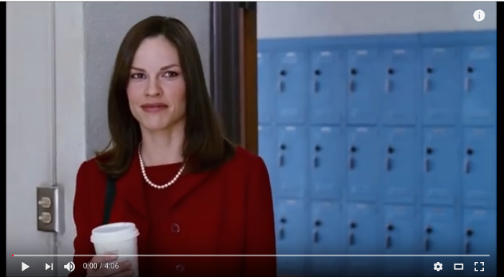
First Day + Solution https://www.youtube.com/watch?v=bENwM8IiCsQ https://www.youtube.com/watch?v=eYYf-mUmPqI

Slide 39
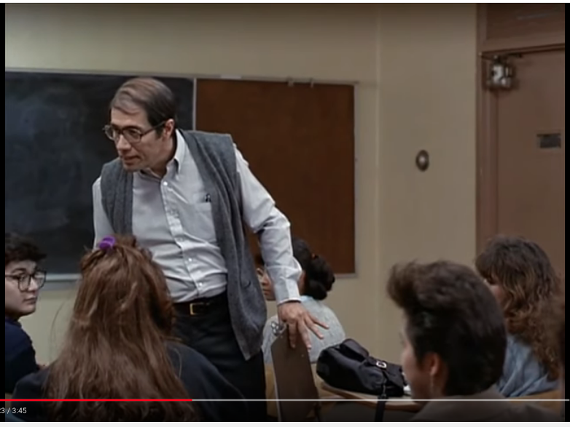
Watch the video and explain what he did: https://www.youtube.com/watch?v=Q3a-bXXN9Xc

Slide 40
BREAK!

Slide 41
Classroom Procedures Activity
Write a syllabus type for your classroom answering the following questions:
Lunch procedure, specials, walking down the hallway, recess
Transition between classes/subjects procedure
Homework procedure, what happens if a student didn’t do homework
Where should students keep homework papers, returned papers, for how long?
How do you want students to turn in their work
What do you want to do with unfinished work, missed assignments?
How do you want to get students’ attention
What should students do if they finish early
How do you want to pass out assignments/collect assignments
How can students get scratch paper, eraser
Can students chew gum, eat candy?
What will you do when a student does not follow your instruction?
How can a student get to the nurse
Can students get up and move during class
Lunch procedure, specials, walking down the hallway, recess
Transition between classes/subjects procedure
Homework procedure, what happens if a student didn’t do homework
Where should students keep homework papers, returned papers, for how long?
How do you want students to turn in their work
What do you want to do with unfinished work, missed assignments?
How do you want to get students’ attention
What should students do if they finish early
How do you want to pass out assignments/collect assignments
How can students get scratch paper, eraser
Can students chew gum, eat candy?
What will you do when a student does not follow your instruction?
How can a student get to the nurse
Can students get up and move during class

Slide 42
Books and Movies Recommendations
Freedom Writers
Stand and Deliver
Kindergarten Cop
Remember the Titans
Gifted Hands
The Ron Clark Story
First Day of School
Teach Like a Champion
The End of Molasses Classes
The Art and Science of Teaching
Teach Like Your Hair’s on Fire

