Slide 1
Today is Monday, August 20, 2018
Instructions:
Sit in any student desk, hang your backpack on the chair
Work on the crossword (with friends / or alone) for 10 min
If you don’t know the answer, skip that question
If finished early, raise your hand
If you brought supplies, put them on the round table
Expectations:
Read the poster on the board

Slide 2
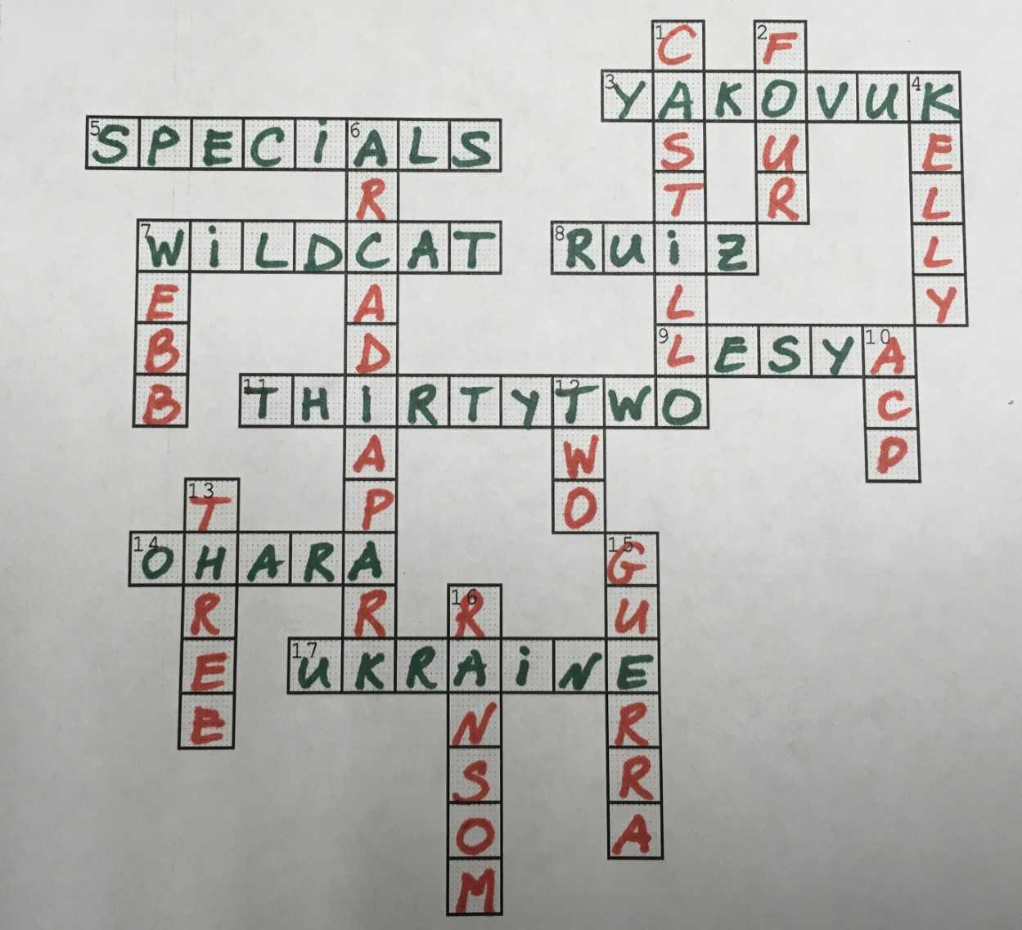
Crossword Key
* Newsletter

Slide 3
Class supplies
Take home:
Binder (keep homework inside)
Earphones (inside pencil pouch)
Clear plastic backpack – if you don’t have one, don’t bring any
Keep in class: (if you are short on any of these, we will figure it out!)
Composition notebook
Spiral notebook
Folder with brads

Slide 4
Welcome to Ms. Yakovuk’s Classroom!
All about Ms. Yakovuk - https://prezi.com/_wlgcnxqderb/all-about-ms-yakovuk/?webgl=0
6th grade

Slide 5
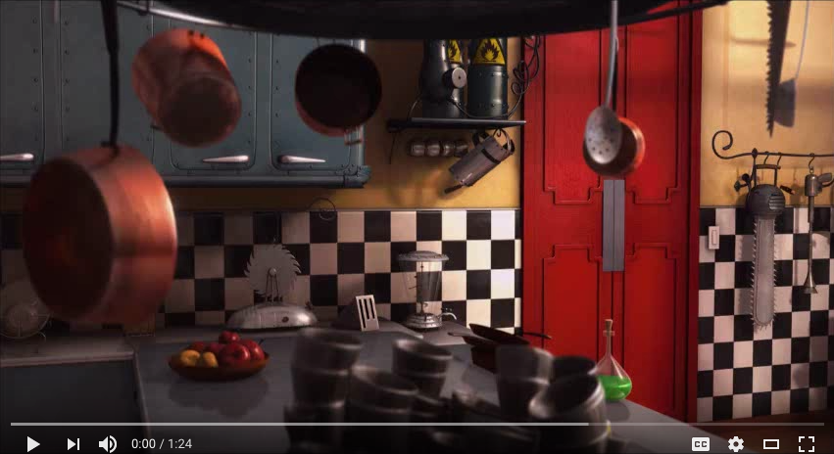
Classroom Expectations
Español

Slide 6
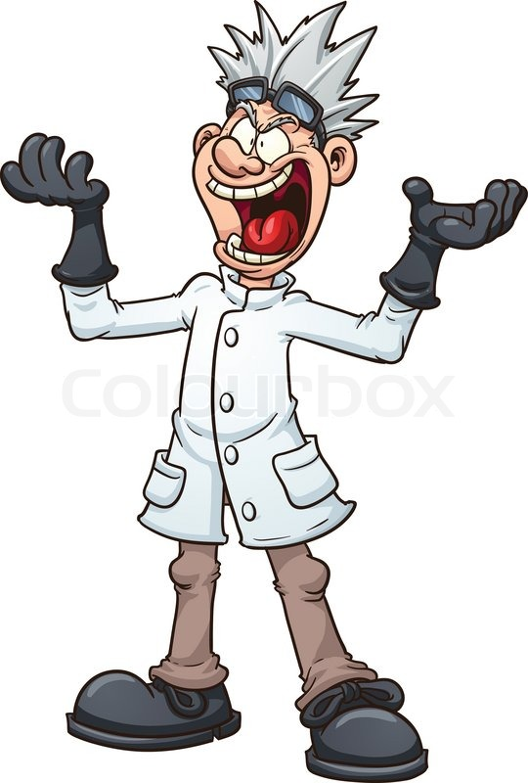
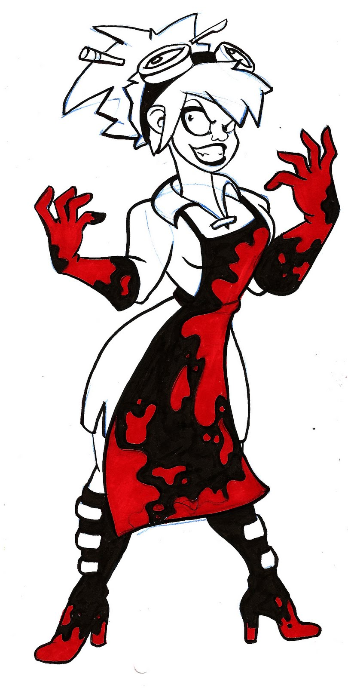
Classroom Expectations
Expectations
1. Pay attention
2. Stay on task
3. Be respectful
4. Do your best
5. Follow all safety requirements
Rewards
1. The joy of learning
2. Call / Text home
3. Small gifts
4. Parties
5. Extra recess, free time
Consequences
1. Warning
2. Loss of a privilege
3. Time off recess
4. Lost recess, extra work
5. Call/Text home
6. Office referral
* If you misbehave during the lab, you will Not participate in labs!

Slide 7
Expectations
Show respect
Wait to be called on after raising hand
Do NOT speak out of turn
Do NOT get up from the seat without permission
No gum, candy, or toys
Wait in line properly, do NOT touch the wall or others

Slide 8
Breakfast
School opens at 7
Eat between 7:30 and 7:40 in the cafeteria
Walk up the stairs at 7:40
Class starts at 7:55
Lunch / Specials
Lunch – 11:50
Specials 12:20

Slide 9
Tissue Policy
May go any time
Raise your hand properly
Wait for the teacher’s signal to go
Use it, throw it away, sit down

Slide 10
Bathroom Policy
May go any time – you abuse the privilege, you lose it!
Raise your hand properly
Wait for the teacher’s signal to go
Go one at a time (one student at a time)
Use the bathroom at the end of the hall

Slide 11
Water Policy
May go any time - you abuse the privilege, you lose it!
Raise your hand and wait for the teacher’s signal
Go one at a time (one student at a time)
Drink from the water fountain in class

Slide 12
Pencils Policy
Raise your hand and wait for the teacher’s signal
Get a pencil and keep it
If it broke, raise your hand, wait for the teacher, go switch it
May write with a blue or black pen

Slide 13
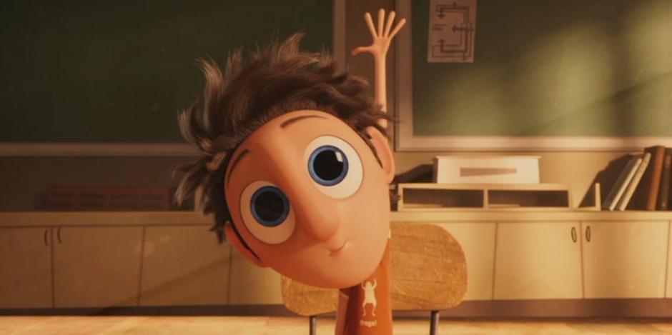
Questions Policy
Raise your hand
When unsure, it is always better to ask
Need attention??

Slide 14
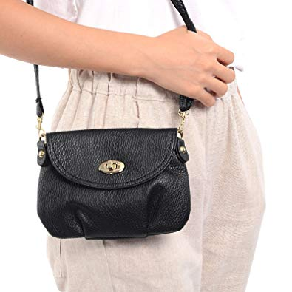
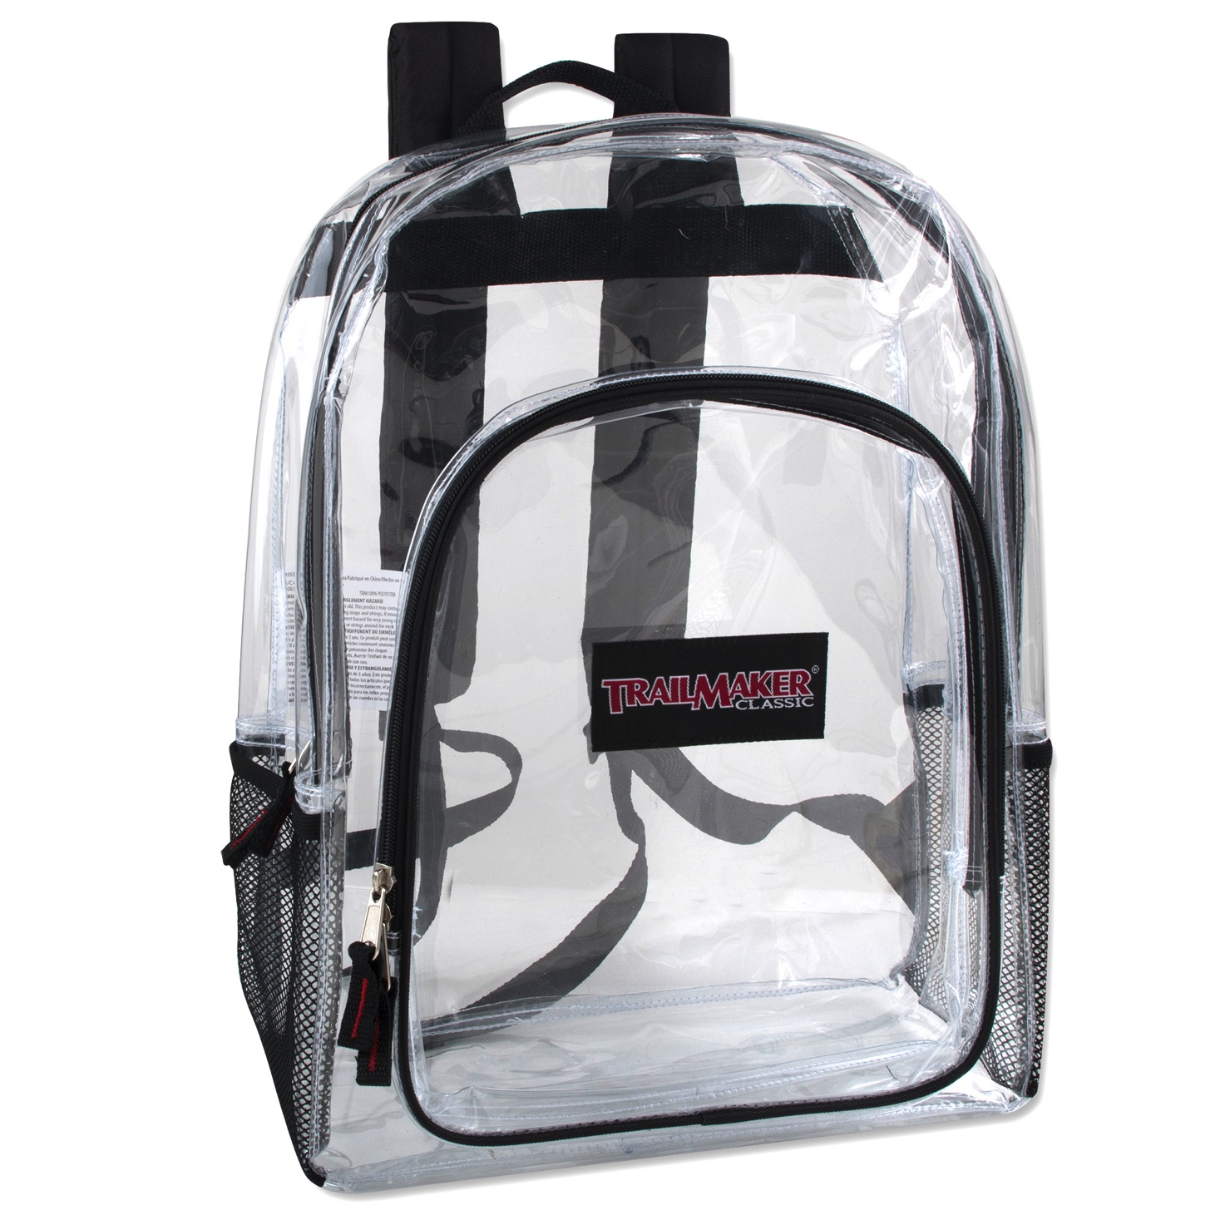
Purses Policy
May keep with you – you abuse the privilege, you lose it!
If you play with it, it will be taken up
Backpacks Policy
Clear backpacks
Others, leave at home
Keep with you all day
Hang on the back of the chair

Slide 15
Dress Code Policy
Wear uniform at all times
Undershirts and jackets must be in school color
No hoodies allowed
Shirts must be tucked in
No sagging pants
Wrong color – must take it off

Slide 16
Cellphone Policy
Keep it turned off
Keep it in your backpack
It rings, we take it up
It comes out of the backpack – we take it up
No cellphone during the school hours

Slide 17
Dismissal Policy
Dismissal – 3pm
Bus riders – go to the front
Pack up at 2:55
Get your homework
Walk down the stairs at the back

Slide 18
Pet Peeves
Touch stuff without permission
Go to the teacher’s desk without permission

Slide 19
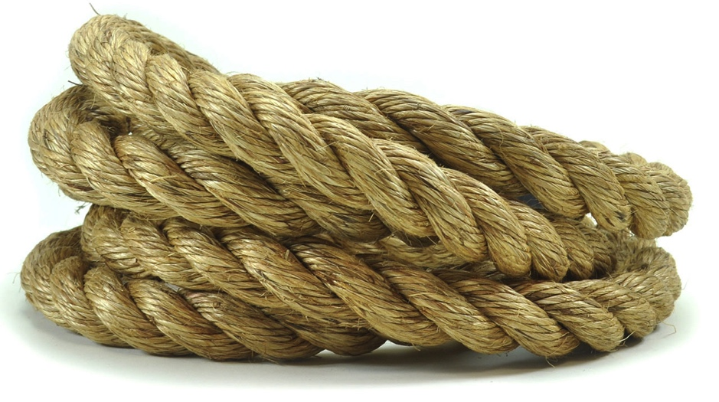
The Bottom Line
You act right and follow rules →
The more freedom you have, the more fun we have
You don’t act right and break rules →
The less freedom you get, the less fun it is for you

Slide 20
If you don’t want to learn no one can help you;
if you want to learn no one can stop you!

Slide 21
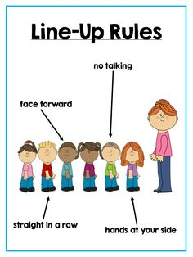
How do we line up / walk the hallway?
H A L L
H hands to the side or behind your back
A all eyes forward
L lips sealed
L low speed

Slide 22
TEKS: 6.1A – Safe Practices
LO: I can demonstrate safe practices during a science classroom.

Slide 23
TEKS: 6.1A – Safe Practices
DOL: Given a picture of “What Not to Do Lab” I will write 3 unsafe lab practices.

Slide 24
TEKS: 6.1A – Safe Practices
DOL: Given classroom behavior statements I will select correct and incorrect behavior.

Slide 25
Science Lab Safety
https://prezi.com/8ya_zagrgli9/6th-grade-science-lab-safety/?webgl=0

Slide 26
DOL – in spiral notebook

